Slide 1
Feature Selection Based on Mutual Information: Criteria of Max-Dependency, Max-Relevance, and Min-Redundancy
Hanchuan Peng, Member, IEEE, Fuhui Long, and Chris Ding
2005

Slide 2
Max-Relevance
The optimal characterization condition often means the
minimal classification error.
selecting the features with the highest relevance to the target class c.
Relevance ： mutual information

Slide 3
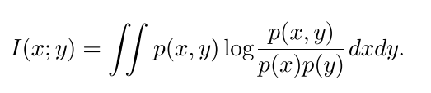
mutual information
random variables x and y, probabilistic density functions p(x), p(y), and p(x; y):

Slide 4
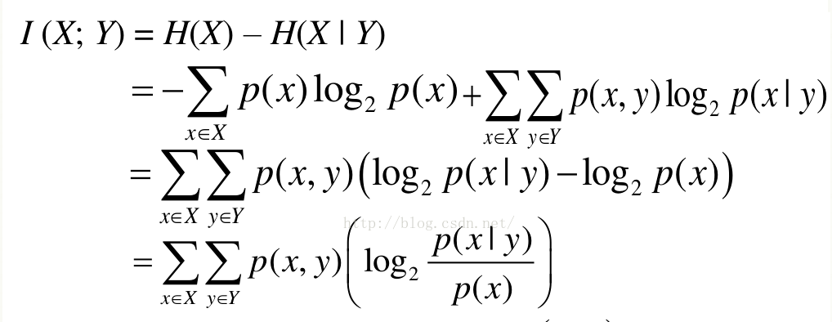
mutual information
Entropy H(X), conditional entropy H(X|Y);
I(X;Y) :由于知道 Y 值而造成的 X 的不确定性的减小

Slide 5
Max-Relevance
Feature xi, target class c;
Largest MI I(xi;c) reflecting xi have the largest dependency on target class;
Squential search:
select top m features in the descent ordering of I(xi;c);

Slide 6
Min-Redundancy
Combinations of individually good features do not necessarily lead to good classification performance.
In other words, “the m best features are not the best m features”
reduce the redundancy among features; select features with the minimal redundancy (Min-Redundancy)

Slide 7

Max-Dependency
Find a feature set S with m features {xi}, which jointly have the largest dependency on the target class c.

Slide 8
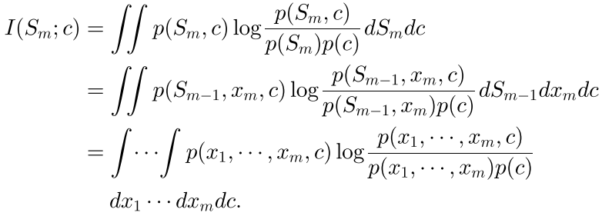

Max-Dependency
given the set with m-1 features, $S_{m−1}$, the mth feature can be determined as the one that contributes to the largest increase of I(S; c),

Slide 9
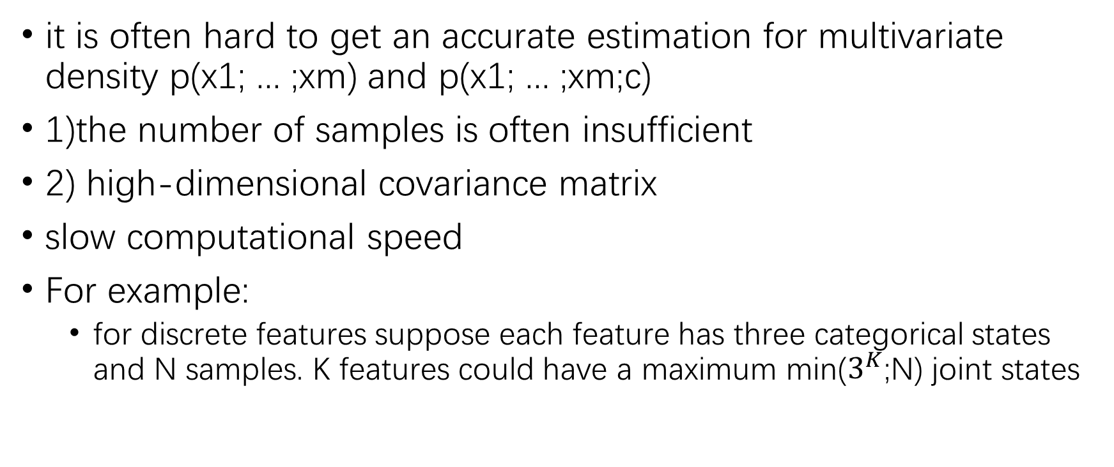
Max-Dependency
it is often hard to get an accurate estimation for multivariate density p(x1; ... ;xm) and p(x1; ... ;xm;c)
1)the number of samples is often insufficient
2) high-dimensional covariance matrix
slow computational speed
For example:
for discrete features suppose each feature has three categorical states and N samples. K features could have a maximum min($3^{K}$;N) joint states

Slide 10
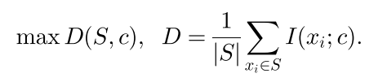
Max-Relevance and Min-Redundancy
alternative is to select features based on maximal relevance criterion (Max-Relevance).
approximates D(S; c) with the mean value of all mutual information values between individual feature xi and class c:

Slide 11
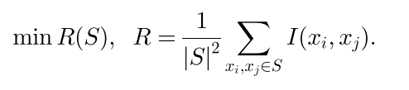
Min-Redundancy
Features selected according to Max-Relevance could have rich redundancy:he dependency among these features could be large.
When two features highly depend on each other, the respective class-discriminative power would not change much if one of them were removed.

Slide 12

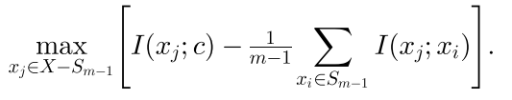

mRMR
Combine D and R:
Incremental search:
With feature set $S_{m−1}$ with m-1 features, to find mth feature in the set
{X - $S_{m−1}$} by maximizes $Φ$

Slide 13
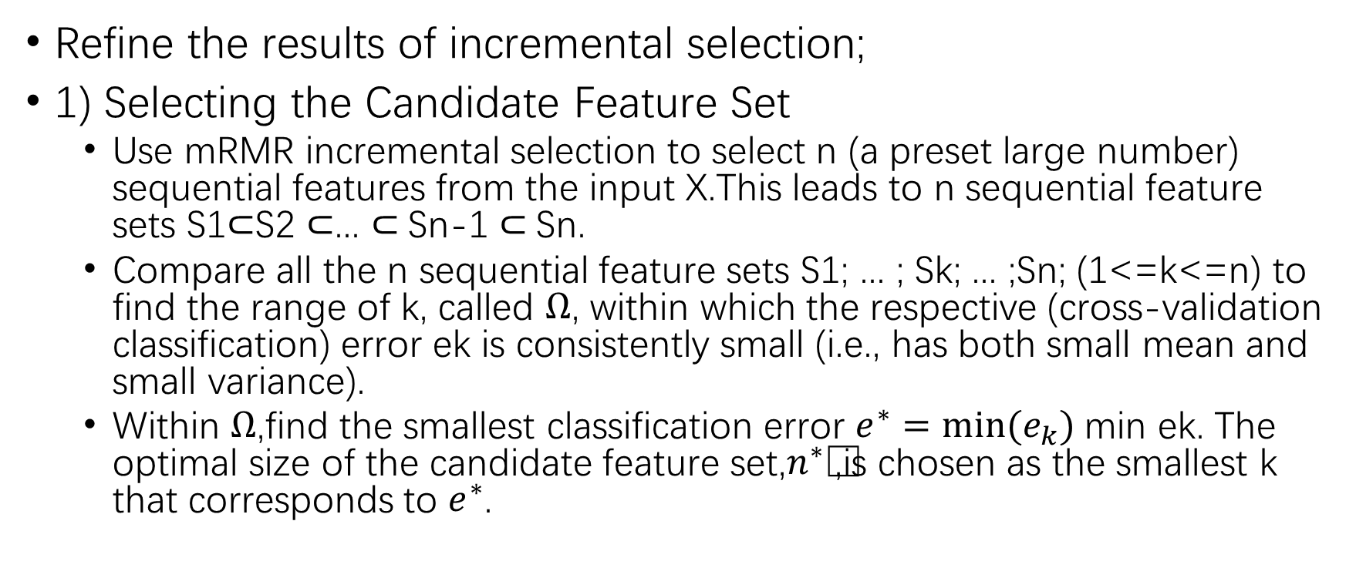
two-stage feature selection algorithm
Refine the results of incremental selection;
1) Selecting the Candidate Feature Set
Use mRMR incremental selection to select n (a preset large number) sequential features from the input X.This leads to n sequential feature sets S1$⊂$S2 $⊂$... $⊂$Sn-1 $⊂$Sn.
Compare all the n sequential feature sets S1; ... ; Sk; ... ;Sn; (1<=k<=n) to find the range of k, called $Ω$, within which the respective (cross-validation classification) error ek is consistently small (i.e., has both small mean and small variance).
Within $Ω$,find the smallest classification error $e^{∗}=min⁡(e_{k})$min ek. The optimal size of the candidate feature set,$n^{∗}$,is chosen as the smallest k that corresponds to $e^{∗}$.

Slide 14
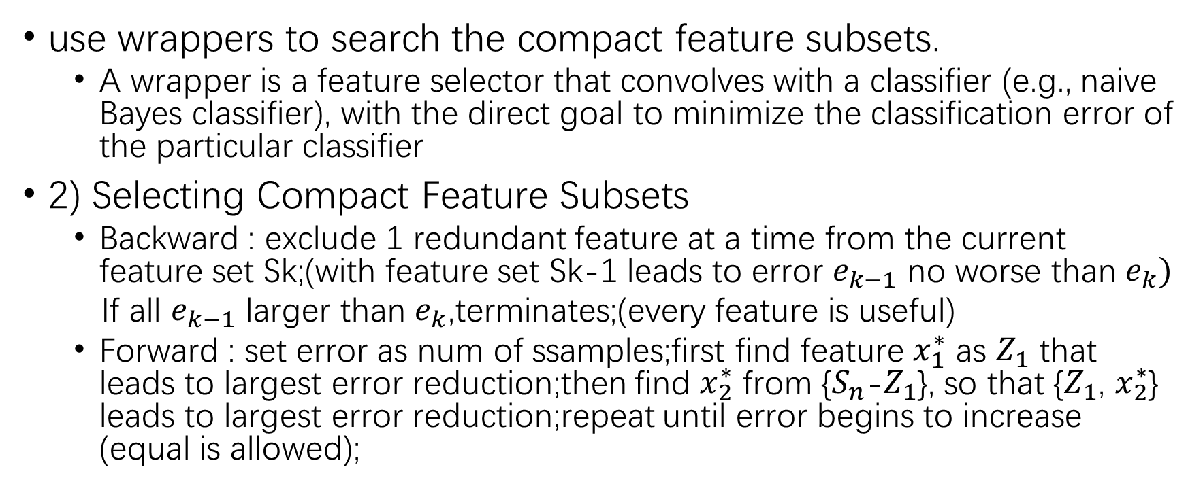
two-stage feature selection algorithm
use wrappers to search the compact feature subsets.
A wrapper is a feature selector that convolves with a classifier (e.g., naive Bayes classifier), with the direct goal to minimize the classification error of the particular classifier
2) Selecting Compact Feature Subsets
Backward : exclude 1 redundant feature at a time from the current feature set Sk;(with feature set Sk-1 leads to error $e_{k−1}$ no worse than $e_{k})$
If all $e_{k−1}$ larger than $e_{k}$,terminates;(every feature is useful)
Forward : set error as num of ssamples;first find feature $x_{1}^{∗}$ as $Z_{1}$ that leads to largest error reduction;then find $x_{2}^{∗}$ from {$S_{n}$-$Z_{1}$}, so that {$Z_{1}$, $x_{2}^{∗}$} leads to largest error reduction;repeat until error begins to increase (equal is allowed);
Errors [10, 8, 4, 4, 4, 7] terminate at 5 but return 3

Slide 15
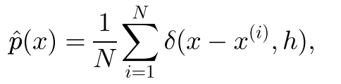
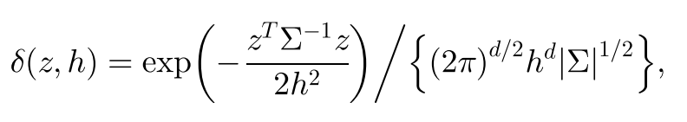
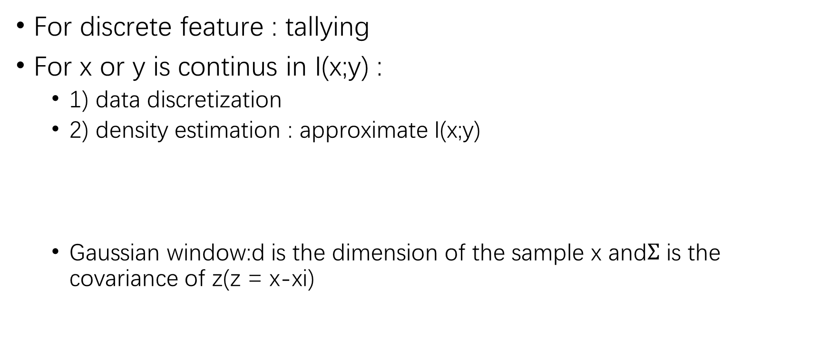
Mutual information estimation
For discrete feature : tallying
For x or y is continus in I(x;y) :
1) data discretization
2) density estimation : approximate I(x;y)
Gaussian window:d is the dimension of the sample x and$Σ$ is the covariance of z(z = x-xi)

Slide 16
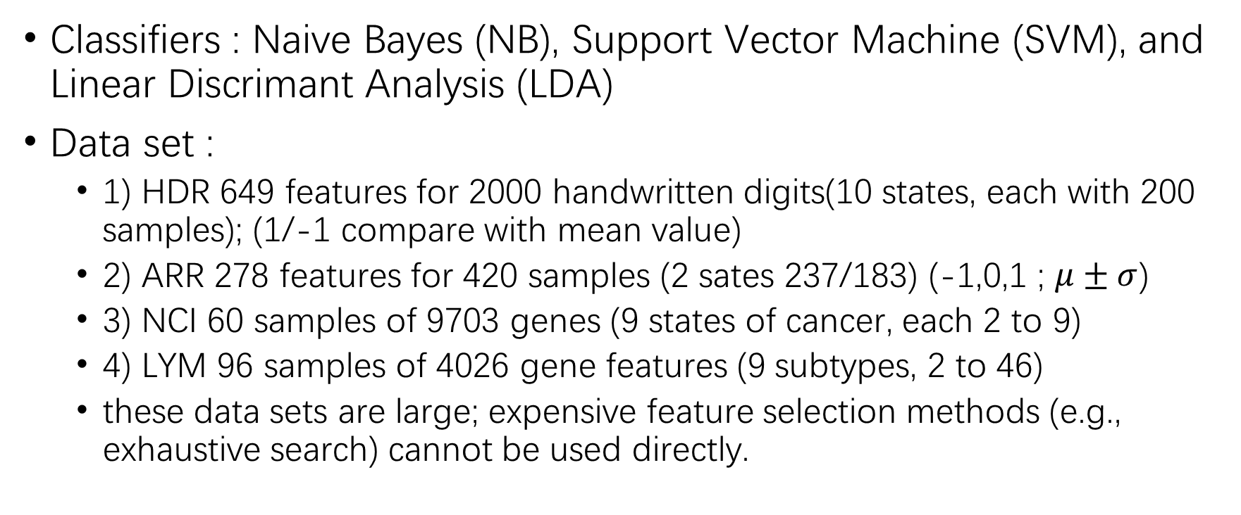
EXPERIMENTS
Classifiers : Naive Bayes (NB), Support Vector Machine (SVM), and Linear Discrimant Analysis (LDA)
Data set :
1) HDR 649 features for 2000 handwritten digits(10 states, each with 200 samples); (1/-1 compare with mean value)
2) ARR 278 features for 420 samples (2 sates 237/183) (-1,0,1 ; $μ±σ$)
3) NCI 60 samples of 9703 genes (9 states of cancer, each 2 to 9)
4) LYM 96 samples of 4026 gene features (9 subtypes, 2 to 46)
these data sets are large; expensive feature selection methods (e.g., exhaustive search) cannot be used directly.

Slide 17
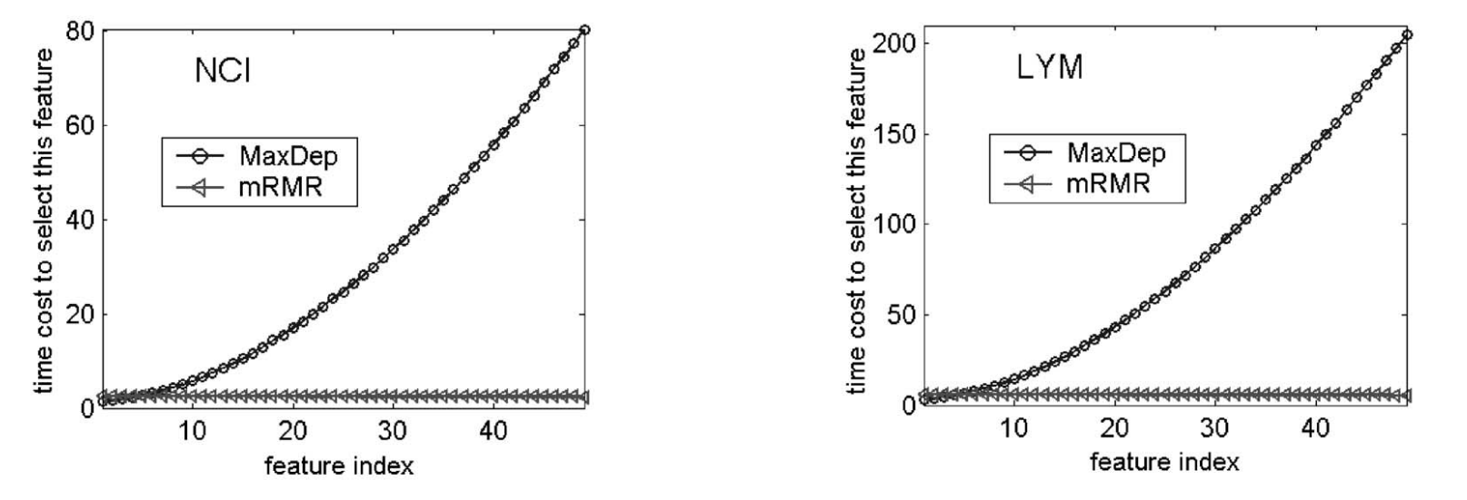
Comparison of mRMR and Max-Dependency
Complexity
MaxDep to select a single feature is a polynomial function of the number of features, whereas, for mRMR, it is almost constant.

Slide 18
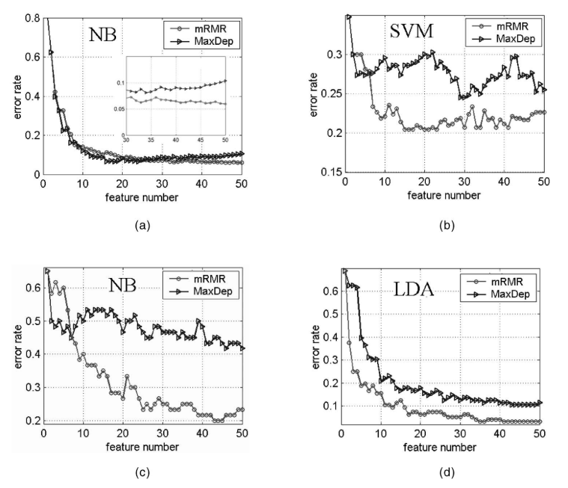
Comparison of mRMR and Max-Dependency
Feature Classification Accuracy
a)For mRMR, the error rate constantly decreases and converges;the error rate for MaxDep declines for small feature numbers and then starts to increase for greater featurenumbers, indicating that more features lead to worse classification.
b,c,d)...

Slide 19
Comparison of mRMR and Max-Dependency
Feature Classification Accuracy
Why?
in highdimensional space, the estimation of mutual information becomes much less reliable than in two-dimensional space, especially when the number of data samples is comparatively close to the number of joint states of features.
(in a difference between mRMR and MaxDep is not prominent because sample number is much large)

